Slide 1
DATA SCIENCE PROJECT
Prediction of Traffic volumes in a city.
GROUP 4
1801EE38 1801EE40 1801EE48 1801EE51

Slide 2
PROJECT DESCRIPTION
An Intelligent Transportation System forms an integral component of a smart city. Formulation of traffic policy and well regulated traffic operation facilitates smooth mobility behaviour in the city. Traffic volume prediction is a challenging research field when the whole city is concerned. Our goal is to best approximate the prediction at multiple source and destination pairs of the city and for few time steps ahead in the future.

Slide 3
We look at the best utilisation of the available resources to improve the prediction. For our objective, we would look into some feature engineering techniques like dimensionality reduction, data-imputation and data-analysis concept like classification, clustering etc and few matrix based concepts SVD, PCA etc. Few forecasting concepts using ANN, ARIMA etc.

Slide 4
MID SEMESTER GOAL
For this project firstly we have covered topics such as Eigen Decomposition, Singular Value Decomposition, Dynamic Mode Decomposition. Then we have taken Data of Thessaloniki City from January to March 2015, then we applied DMD approach to predict the traffic data and finally computed the root mean square error.

Slide 5
Eigen Decomposition
Let X be a square n × n matrix with n linearly independent eigenvectors q_{i} (where i = 1, ..., n). Then X can be factorized as
X=QΛQ⁻¹
where Q is the square n × n matrix whose ith column is the eigenvector q_{i} of X, and Λ is the diagonal matrix whose diagonal elements are the corresponding eigenvalues, Λ_{ii} = λ_{i}.

Slide 6
Singular Value Decomposition
Let X be a real or complex m x n matrix which can be decomposed by using SVD in form of
X=UΣV⁻¹
Where U is the Eigen matrix of XX⁻¹, V is the eigen matrix of X⁻¹X and Σ be the diagonal matrix of singular values of X which can be calculated by taking square root of eigen values of either XX⁻¹ or X⁻¹X.

Slide 7
XX⁻¹_{(mxm)}=UΣ²U⁻¹
Comparing it with standard eigen decomposition we can observe that Σ is the square root of eigen values of XX⁻¹.
X⁻¹X_{(nxn)}=VΣ²V⁻¹
Comparing it with standard eigen decomposition we can observe that Σ is the square root of eigen values of X⁻¹X.

Slide 8
Principal Component Analysis
The idea of principal component analysis (PCA)
Is to reduced the reductancy and noise of a data set consisting of many variables correlated with each other. First we construct a covariance matrix whose diagonal elements are variance measures and rest of elements are covariance measures
C_{x}=(1/(n-1))*XX⁻¹
Where X is our data matrix.

Slide 9
Variance can be computed by using this formula σ_{x}²=(1/(n-1))*xx^{T}
And covariance between two vectors can be computed by using this formula
σ_{xy}²=(1/(n-1))*xy^{T}
And our aim is to make the covariance matrix such that it’s non-diagonal elements reduces to zero, this will help us to kill out all the related data in original data set. We can do this by transforming Original data matrix with respect to U^{T}.

Slide 10
Dynamic Mode Decomposition
Let X be the given data from which we have to predict the future data which is X’. Then we can define a matrix A which will help us to predict future results.
X’=AX
X=UΣV⁻¹
X’=AUΣV⁻¹

Slide 11
U⁻¹X’VΣ⁻¹=U⁻¹AU=Ă
ĂW=W∧
X’VΣ⁻¹ĂW=X’VΣ⁻¹W∧
(X’VΣ⁻¹U⁻¹)(X’VΣ⁻¹W)=(X’VΣ⁻¹W)∧
X’X⁻¹(X’VΣ⁻¹W)=(X’VΣ⁻¹W)∧
AΦ=Φ∧
We have not directly computed A because of computation efficiency instead we computed Ă
Which can be computed with much lesser computation, and we will predict future results using eigen decomposition of A for which we will be needed

Slide 12
With the eigenvalues and eigenvectors of A. For this purpose we take eigenvalue of A as ∧(the eigen values of Ă), and we can observe from previous slide if we do so eigen vectors of A will be
Φ=X’VΣ⁻¹W.
We are using DMD approach because it is a data driven technique.

Slide 13
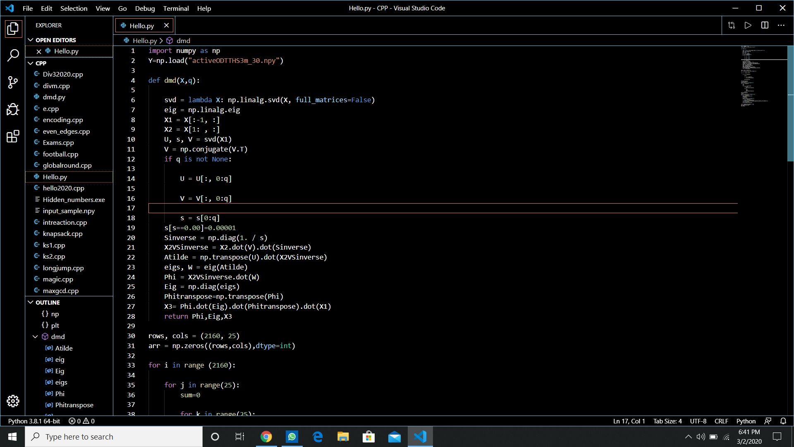

Slide 14
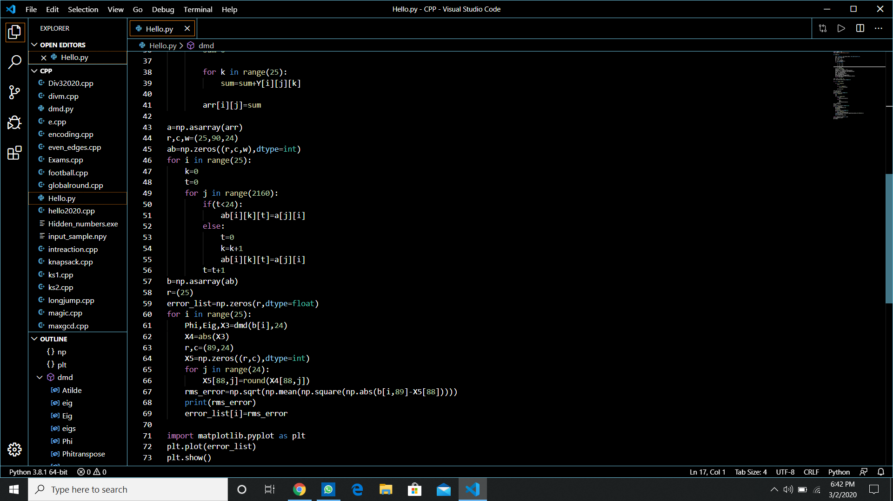

Slide 15
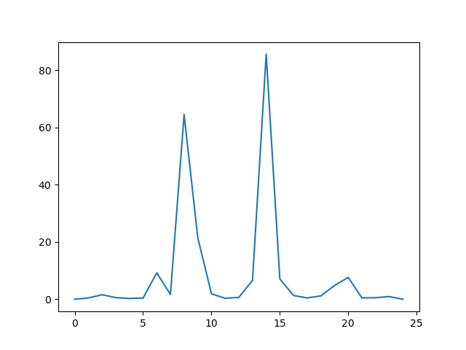
Results We Got
RMS_Error per hour
LOCATIONS

Slide 16
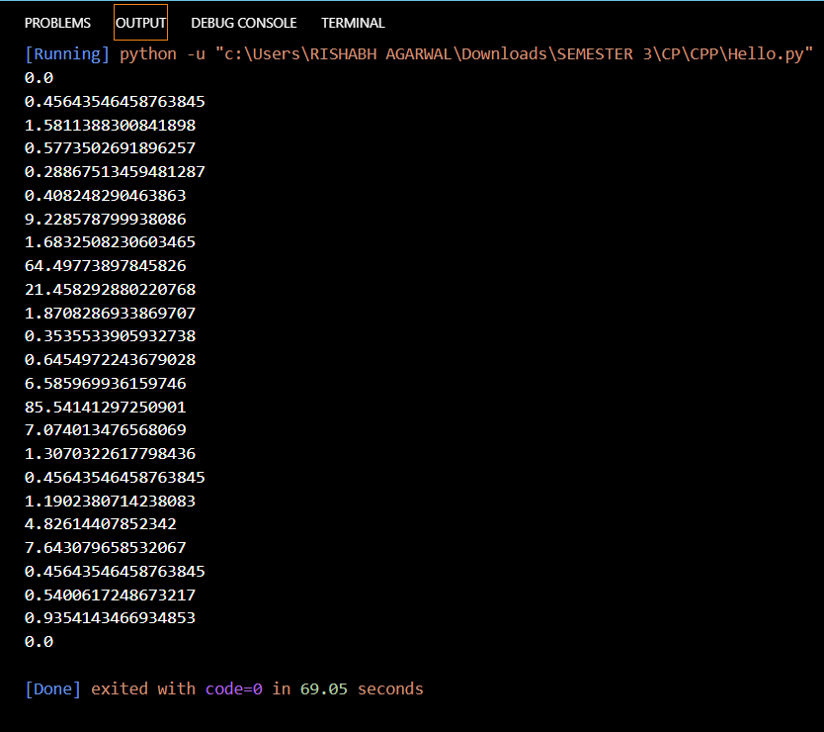
RMS ERROR
VALUES PER
HOUR ON
EVERY
LOCATION

